Slide 1
Attrition
DDSAnalytics
Notes:
Hello Welcome to my presentation! My name is Solomon Mathew and today I will be discussing identifying attrition for an employee based on a specific set of features/attributes. What is attrition? Attrition is the process of an employee leaving their company or turning over, and why is this problematic? Typically companies invest a lot of resources when selecting new employees, so making the employee stick/stay is of great benefit to the company. So we will be looking to identify from the dataset given to me by Frito lay to identify the top 3 factors that may lead to attrition as well creating and training and testing a model on the features in the dataset such that at any point with any set of random features of any employee, the model will accurately identify attrition.

Slide 2
Business Understanding
Who am I?
Client?
Frito Lay Executives
Question of Interest?
Predicting Attrition
What are top three attributes/features that lead to turnover?
Notes:
Hello Welcome to my presentation! My name is Solomon Mathew and today I will be discussing identifying attrition for an employee based on a specific set of features/attributes. What is attrition? Attrition is the process of an employee leaving their company or turning over, and why is this problematic? Typically companies invest a lot of resources when selecting new employees, so making the employee stick/stay is of great benefit to the company. So we will be looking to identify from the dataset given to me by Frito lay to identify the top 3 factors that may lead to attrition as well creating and training and testing a model on the features in the dataset such that at any point with any set of random features of any employee, the model will accurately identify attrition.

Slide 3
Data Understanding
Shape of Dataset
870 rows, 36 columns
No missing values
ID and EmployeeNumber contain 0 duplicates
Over18, StandardHours, Employee Count contain 1 unique value
Notes:
From the dataset, we are able to see that there are about 870 rwos and 36 columns.

Slide 4
Data Preparation
First, drop columns
All unique values: ID, EmployeeCount
Only one unique value: Over18, StandardHours
Convert categorical variables to factors
I decided to pursue Naïve Bayes
No need for any encoding, may be good for KNN

Slide 5
Explanatory Data Analysis (EDA)
Correlation Matrix
MonthlyIncome and JobLevel high positive correlation
0.9516
Dropped JobLevel. Why?
Highest Correlated with Attrition
OverTime: 0.272
MaritalStatus: -0.197
JobInvolvement: -0.188
Notes:
Ask for permission to use maritalstatus feature in model first. Also keep in mind, corr is between two continuous variables but here we will continue with using this anyway.

Slide 6
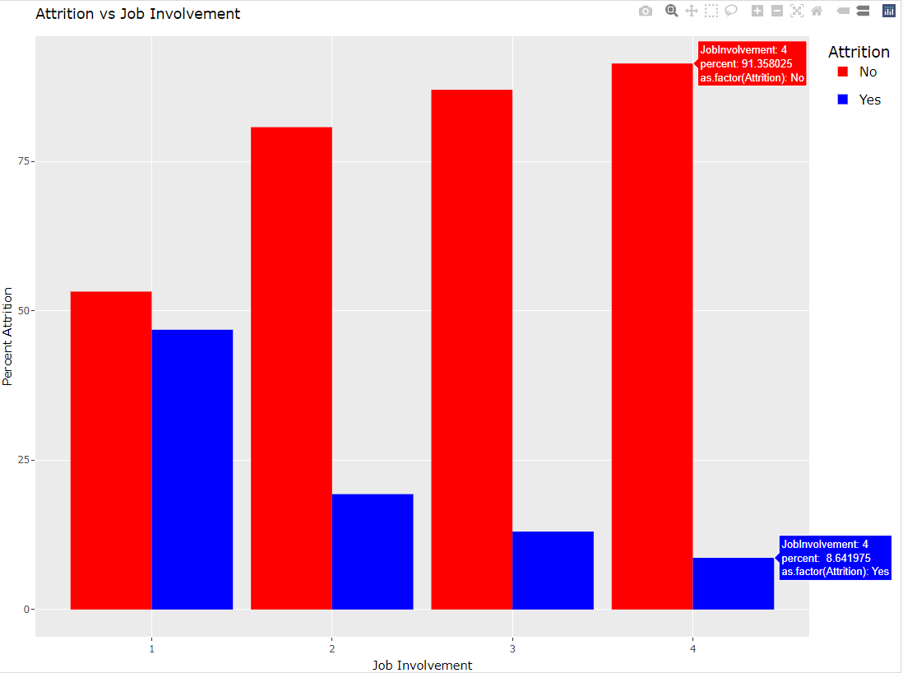
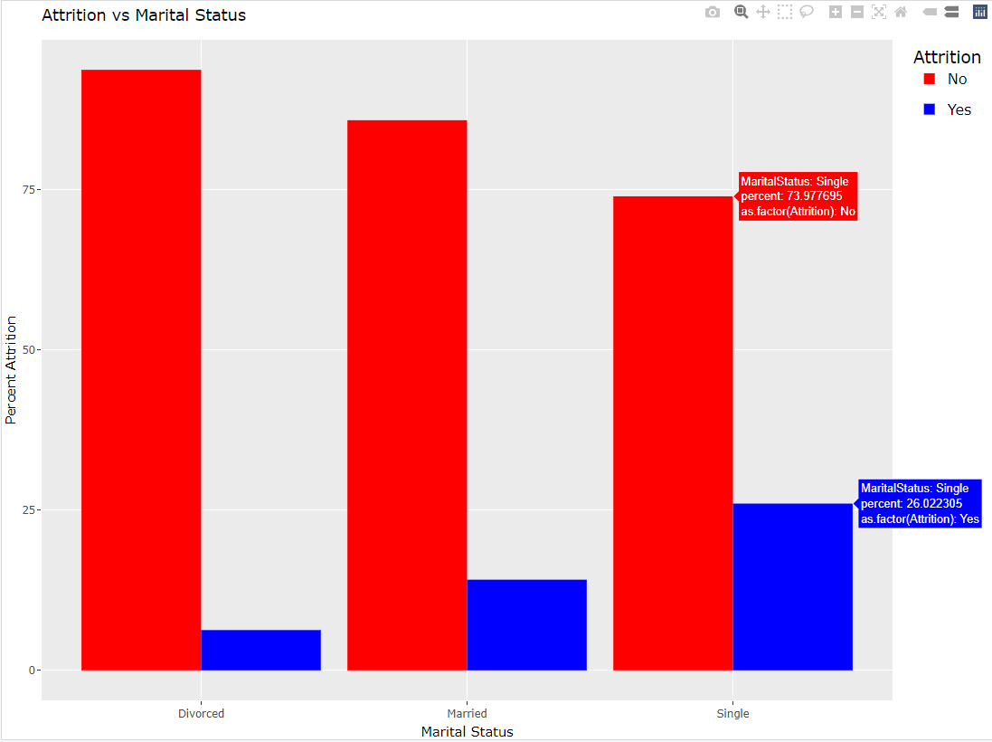
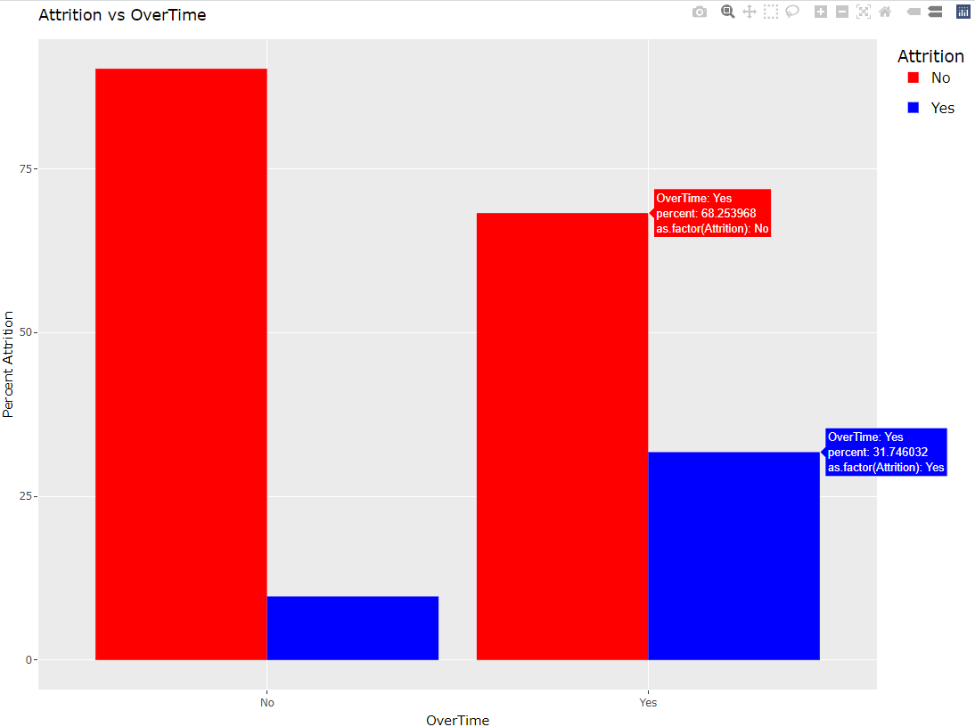
Graphical EDA
Investigating Attrition vs OverTime
More likely to turnover if working overtime
Investigating Attrition vs MaritalStatus
More likely to turnover if working single
Investigating Attrition vs JobInvolvement
More likely to turnover if low job involvement
Notes:
For No overtim: 90% do not turnover, whereas about 32% of those who work overtime do end up turning over.
For single people, 26% attrition, 14% percent married turned over, and divorced 6% turned over. Singles are usually younger and trying to climb positionally and push their ceilings, married people are busy with children, and divorced people have usually have more time and may use work as an outlet
Correlation between less job involvement and higher attrition rate, where 46% of those with low job involvement turning over. A level of 2 (medium invovlement) significantly lowered the attrition percent to 19% and then 13% and then 8% so on. So maybe identifying the job involvement employyes with 1 scores may be crucial.

Slide 7
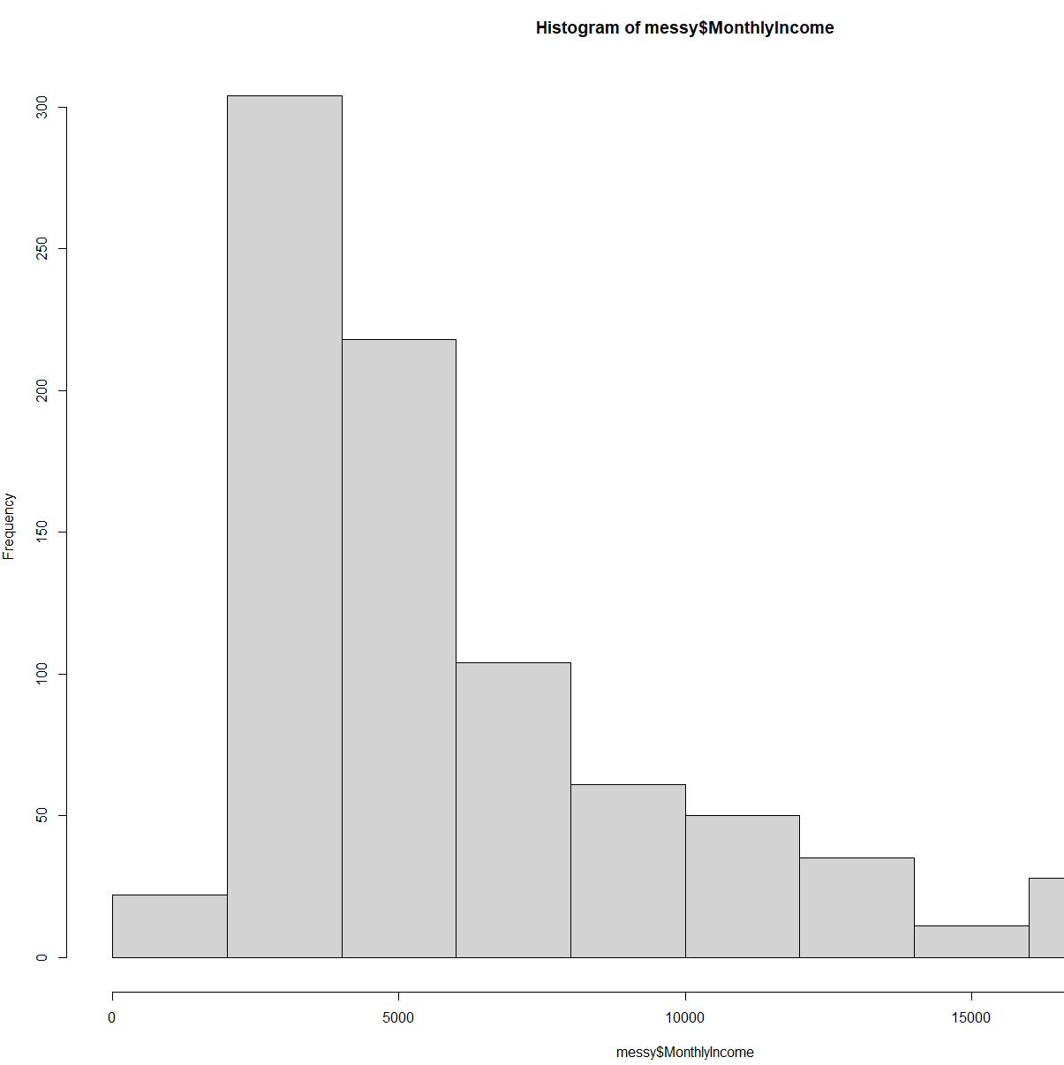
Graphical EDA
MonthlyIncome values much larger than all other values
Heavy Right Skewed
Log transform?

Slide 8
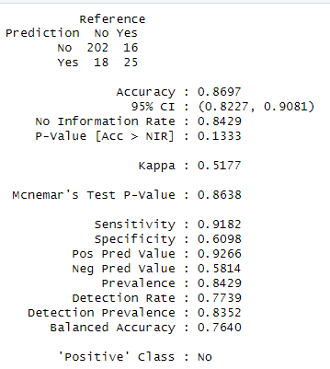
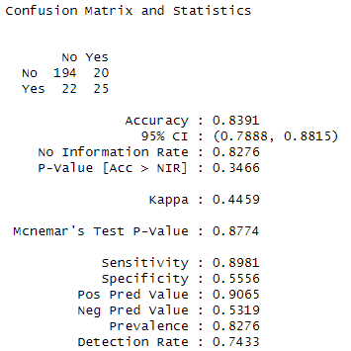
Modeling
Naïve Bayes Classifier
500 iterations
With all attributes, dropping unnecessary attributes
With all attributes, but log transforming MonthlyIncome due to its heavy right skew
Threshold is a problem?
Adjust threshold from > 0.5 to >0.4.
Maybe some overfitting but validation set will tell the story.
Mean Accuracy | Mean Sensitivity | Mean Specificity | Mean F1
0.819 | 0.865 | 0.582 | 0.889
Mean Accuracy | Mean Sensitivity | Mean Specificity | Mean F1
0.823 | 0.872 | 0.567 | 0.892
Mean Accuracy | Mean Sensitivity | Mean Specificity | Mean F1
0.793 | 0.828 | 0.612 | 0.87
No | Yes
730 | 140
Notes:
Uneccessary attributes being ID, EmployeeCount, StandardHours, and EmployeeNumber
Since there is low speficitiy meaning the model is identifying employees who did not stay with company or turned over as No (false positives) 194/194+22 -> sensitivity, 20/20+25 -> specificity
Maybe lower threshold because there are significantly more No’s in the training set than testing set so incorrectly identifying turned over employees as those who stayed. Number of yes’s predicted correctly increased from 20 to 25!

Slide 9
Conclusion
Employees are vital organs
Employees are very important
Resource Allocation
Opportunity Cost
How many left Frito Lay?
So Frito Lay invests resources into studying attrition
44 out 300 employees left in validation set
Notes:
Employees are absolutely vital organs to any company as the company cannot operate without them. This is why Frito Lay is investing resources into identifying highly correlated features that lead to employee attrition as you are in a way trying to protect your investments. When investing resources into recruiting and paying employees, an opportunity cost is incurred where the money could or may have been utilized instead. Thus, the model with it’s high accuracy, sensitivity, and specificity can be utilized to identify employee turnover based on the same features provided in the data. And based on the validation set, it seems about 44 out of 300 employees were predicted by the model as to have left company (Yes).

Slide 10
Thank you!
Name: Solomon Mathew
SMU Email: stmathew@mail.smu.edu
Personal Email: solomontmathew@gmail.com

